Slide 1

Global Terrorism (Part 2 of 2)
Josh Gardner
DSC 680 Applied Data Science

Slide 2
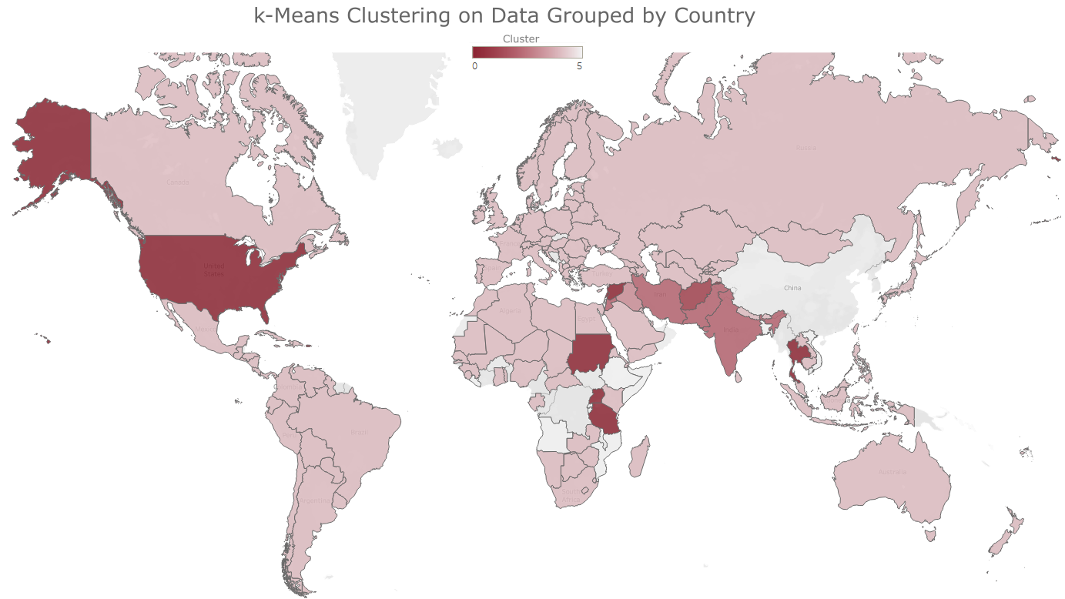

K-Means Clustering When Grouped by Country

Slide 3
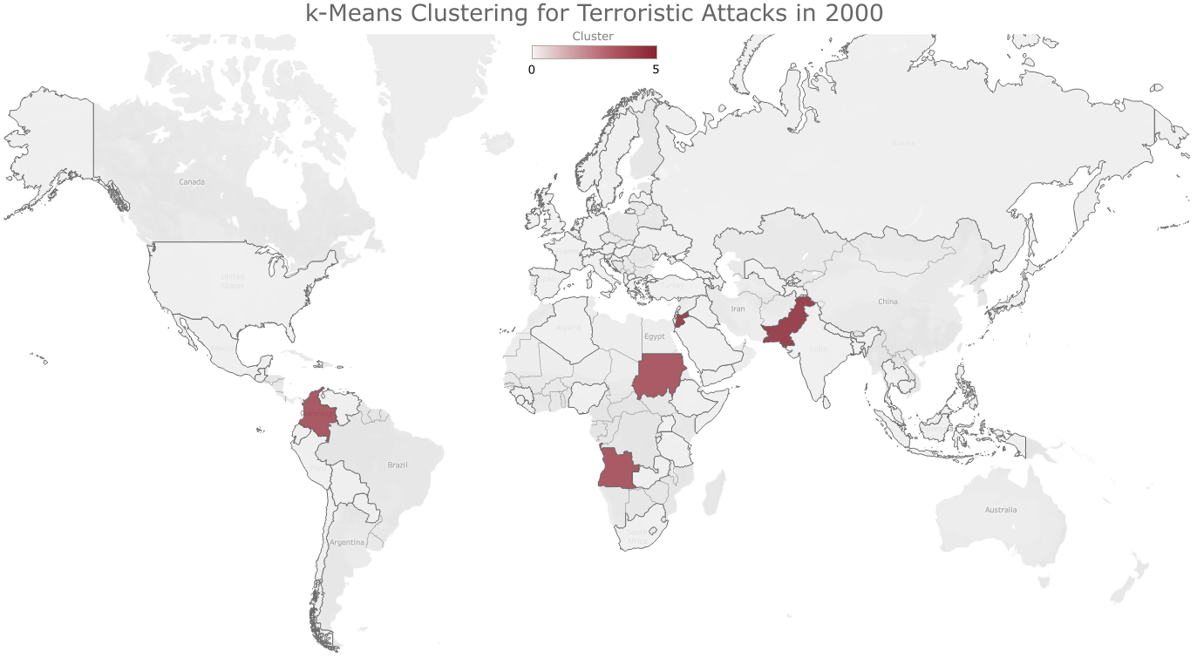
K-Means Clustering by Year, 2000

Slide 4
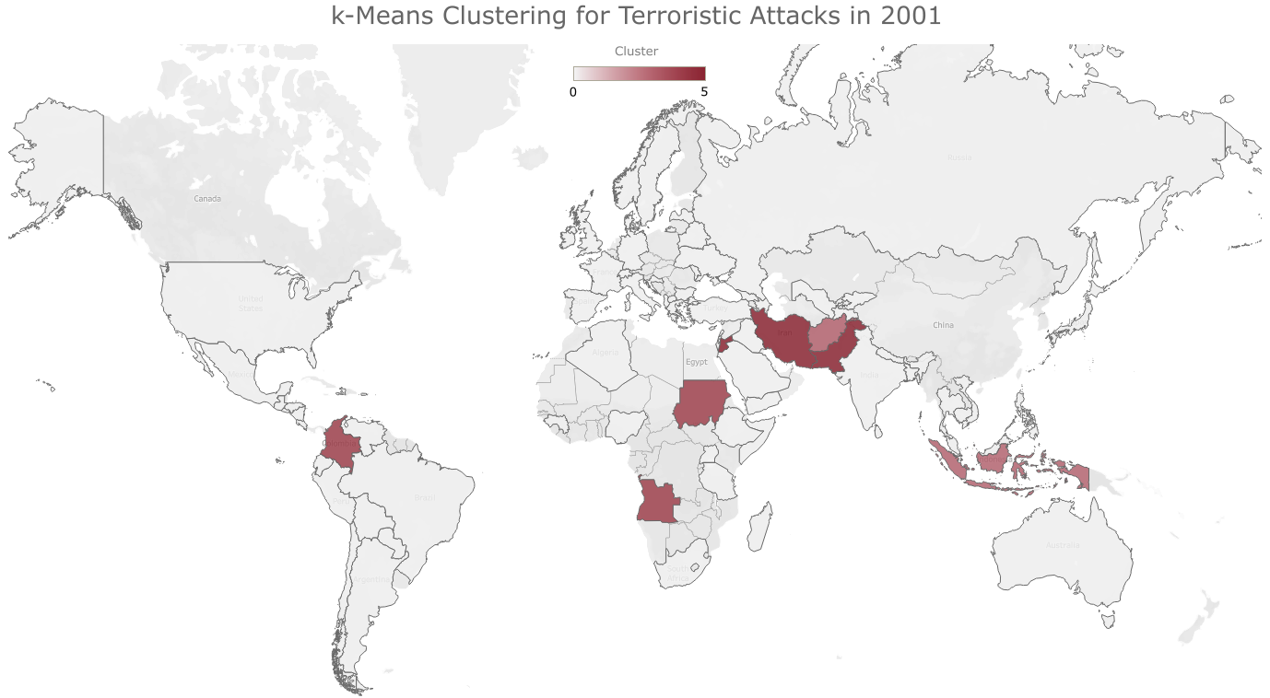
K-Means Clustering by Year, 2001

Slide 5
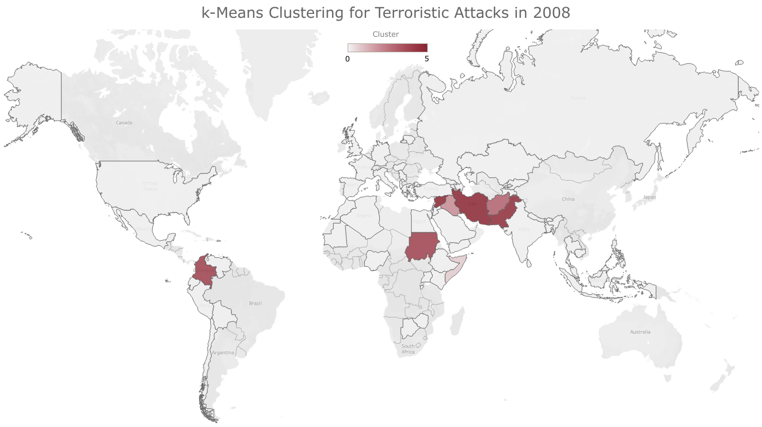
K-Means Clustering by Year, 2008

Slide 6


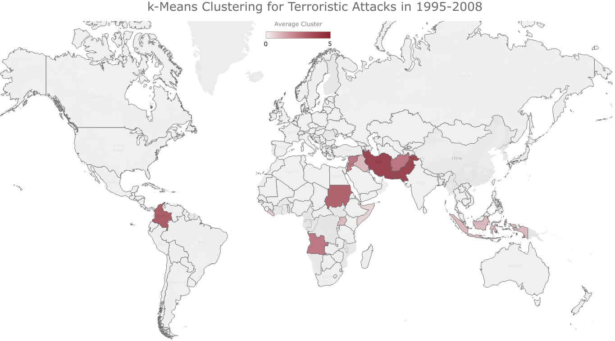
Comparing the Two Clustering Methods

Slide 7
Revisiting Research Questions
1. How does a region’s instability influence the rates of terrorism?
The more unstable a region is, the higher the number of coups
As the region is more unstable, the more people are displaced from that region
There is a weak positive correlation between the region’s stability and the number of injuries and fatalities due to terrorism.

Slide 8
Revisiting Research Questions
2. Does strengthening a region’s stability lower the terrorism rate of that region?
The lower a region’s State Fragility Index is, the lower the terrorism rate in that region typically is.
Fewer coups happen when a region is more stable.

Slide 9
Revisiting Research Questions
3. How can the different acts of terror be grouped together? Can anything be inferred by how the terroristic acts are grouped?
Yes, the different countries can be grouped together using k-Means Clustering.
The groups tend to follow regions, with a few exceptions.
Which countries are within which cluster changes over time.

Slide 10
Revisiting Research Questions
4. Does one region’s terrorism cluster influence another region’s cluster? Specifically, how does the terrorism cluster influence non-adjacent clusters?
One country’s cluster does impact the countries around it.
Country’s in a cluster with higher levels of terrorism are surrounded by clusters that contain a lower level of terrorism, which are then surrounded by clusters with even lower levels of terrorism.

Slide 11
Summary
Terrorism around the world can be grouped together to form clusters of terroristic activity. These clusters are dynamic and do change over time.

Slide 12
Further Research Opportunities
What influences the clusters to change over time?
Would adding the type of weapon used into the analysis change the clusters?

Slide 13
Sources
National Consortium for the Study of Terrorism and Responses to Terrorism (START). (2018). Global Terrorism Database. Retrieved 28 Sep. 2019 from https://www.start.umd.edu/gtd
Roser, M., Nagdy, M., Ritchie, H. (July 2013) “Terrorism.” Our World in Data. Retrieved 28 Sep. 2019 from https://ourworldindata.org/terrorism
“Forcibly Displaced Populations, 1964-2008.” Integrated Network for Societal Conflict Research Center for Systemic Peace. Retrieved 28 Sep. 2019 from http://www.systemicpeace.org/inscrdata.html
“Coups d’Etat, 1946-2018.” Integrated Network for Societal Conflict Research Center for Systemic Peace. Retrieved 28 Sep. 2019 from http://www.systemicpeace.org/inscrdata.html
“State Fragility Index and Matrix, Time-Series Data, 1995-2017.” Integrated Network for Societal Conflict Research Center for Systemic Peace. Retrieved 28 Sep. 2019 from http://www.systemicpeace.org/inscrdata.html
“Political instability task force worldwide atrocities dataset.” The Computational Event Data System. Retrieved 28 Sep. 2019 from http://eventdata.parusanalytics.com/data.dir/atrocities.html
“RAND database of worldwide terrorism incidents (RDWTI).” Rand Corporation. Retrieved 28 Sep. 2019 from https://www.rand.org/nsrd/projects/terrorism-incidents/download.html
Sundberg, Ralph, and Erik Melander, 2013, “Introducing the UCDP Georeferenced Event Dataset”, Journal of Peace Research, vol.50, no.4, 523-532. Retrieved 28 Sep. 2019 from https://www.ucdp.uu.se/downloads/
Högbladh Stina, 2019, “UCDP GED Codebook version 19.1”, Department of Peace and Conflict Research, Uppsala University. Retrieved 28 Sep. 2019 from https://www.ucdp.uu.se/downloads/
Basra, R., Crawford, B., Keen, F. (10 Oct. 2019) Time. “How the synagogue shooting in Germany fits into a global pattern of far-right terrorism.” Retrieved 11 Oct. 2019 from https://time.com/5697553/halle-germany-synagogue-christchurch-terrorism/

